Slide 1

Factors That Affect Basketball Player’s Salary
Team 7
Anthony Nguyen
Helen Au
Shadi Salama
Warren Vince Sy

Slide 2
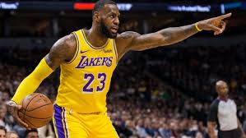
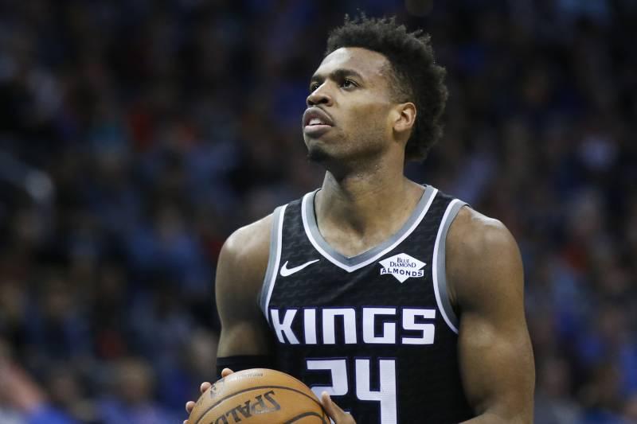
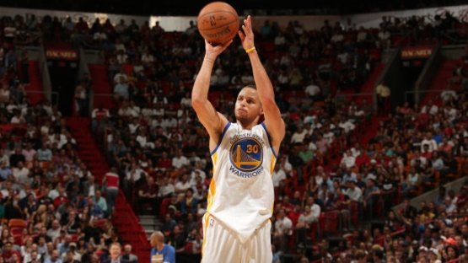

Content
Core hypothesis and main questions
Data source
Data cleaning
Analysis process
Conclusions
Findings
Q&A

Slide 3

Main Questions and Core Hypothesis
Question 1
Are the stats that affect a player’s salary vary by position?
Question 2
What are the top factors that affects the players salary?
Question 3
What Stat does each California Team value?

Slide 4
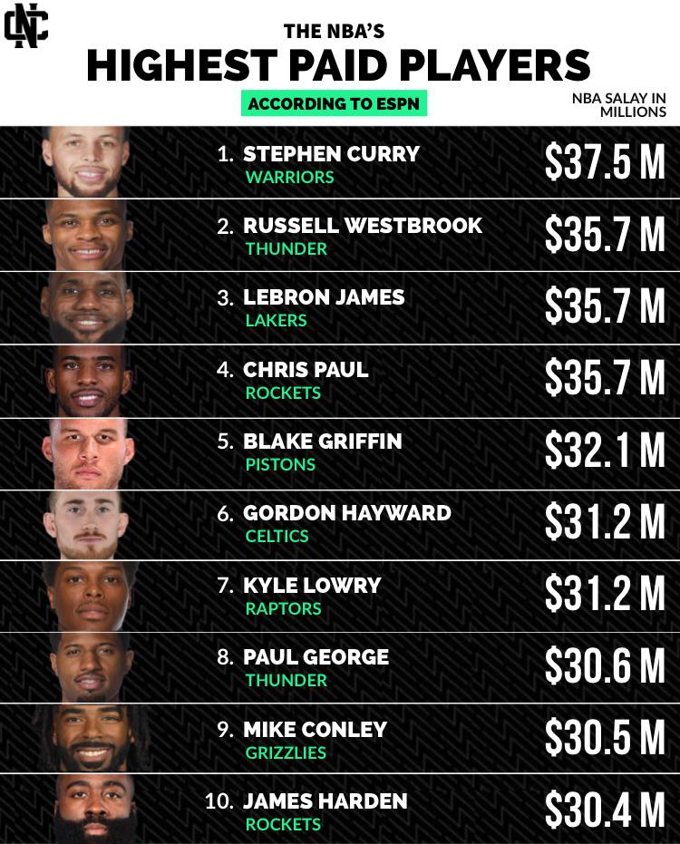
Questions and Data
We originally wanted to use the data from all the NBA teams but due to time constraint in this project we limited it to just the California NBA teams.
We wanted to find correlations and patterns to answer our question of what affects basketball salaries.
We also wanted to know if the stats that affect the salary are the same for all positions.

Slide 5
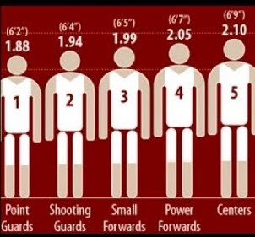
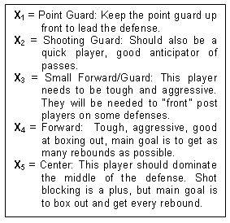
Exploring Questions and Data
Through exploring the data, we realized there were specific responsibilities of each player that may affect the stats, and possibly the salary.
Some players are needed to be more aggressive, get every rebound, anticipate passes, blocking, or focus on shooting from all areas of the court.
We became curious of data if we sorted by position on the court.

Slide 6


Data source
ESPN.com/nba
stats.nba.com
Basketball-reference.com

Slide 7




Teams Analysis
The study includes four team in California
Golden State Warriors
LA Clippers
Sacramento Kings
Lakers

Slide 8

Data Cleaning
Players Stats Dataset
Cleaning process:
Extracted data into a CSV
Added Year Column
Filtered data with California teams only
Players Salaries and Positions Dataset
Cleaning process:
We found the players salaries for all NBA players for the five years in one excel sheet, each year in a workbook/tab.
We imported each list using Jupyter Notebook and Pandas function in five DataFrames.
Then we merged the five dataframes into one dataframe.
Then we renamed the duplicate columns name.
We rearranged the columns order.
Then we filtered the dataframe to include only four teams to create our study sample.

Slide 9
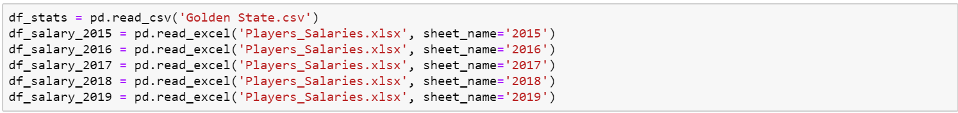
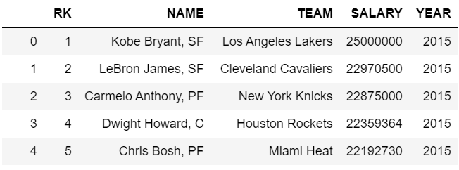
Converting Excel File w/ multiple sheets into a single data frame

Slide 10
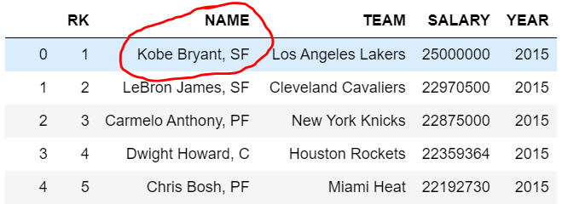
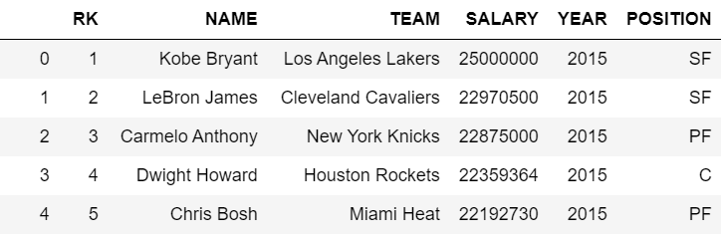
Splitting one column(Name) into two different columns (Name) and (Position)

Slide 11
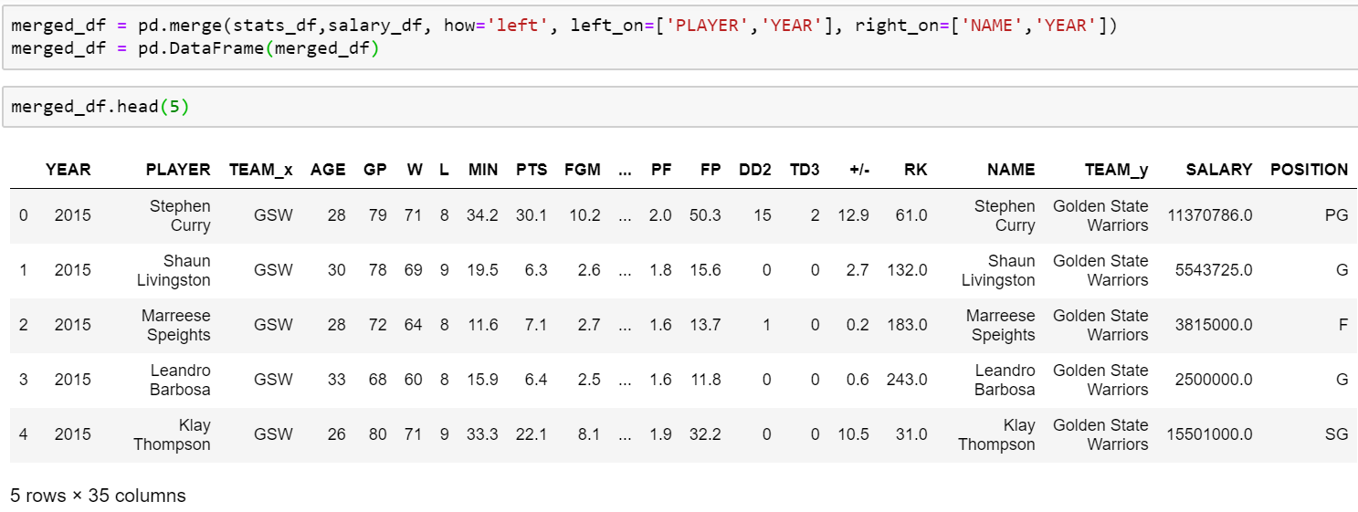
Merge Data Frames using 2 key values

Slide 12
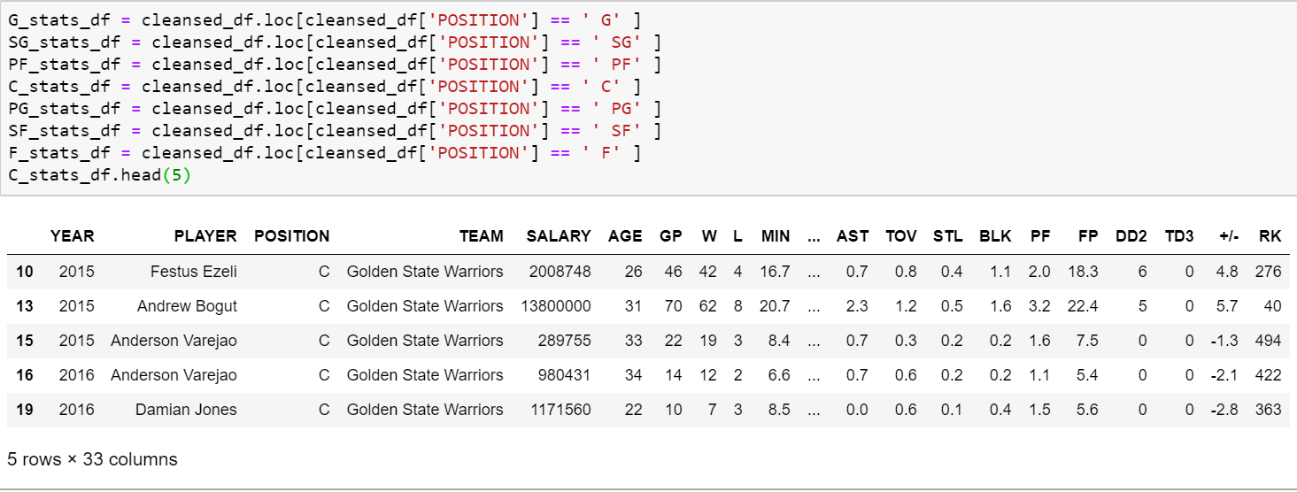
Creating Multiple Dataframes based on Position

Slide 13
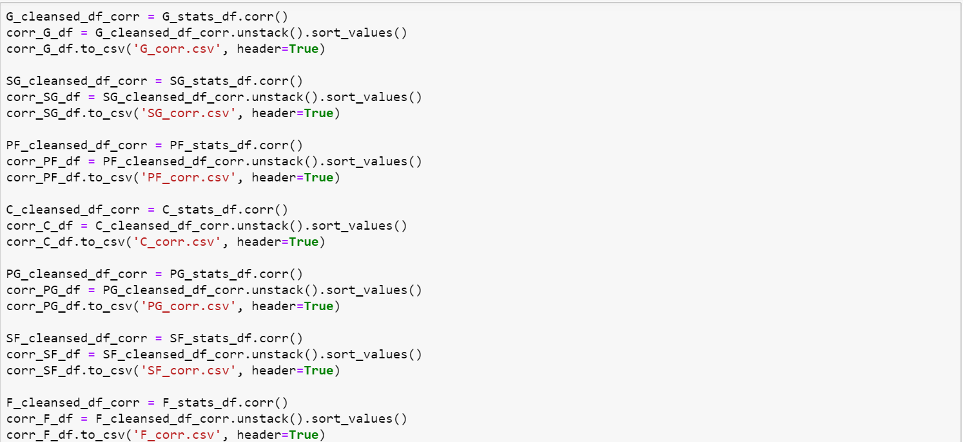
Check Correlation of all stats against salary per position

Slide 14
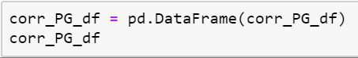
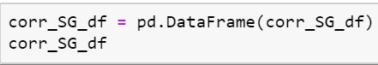
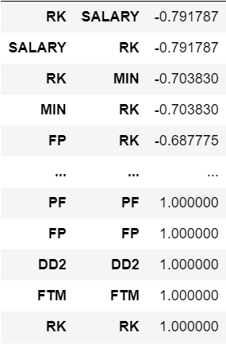
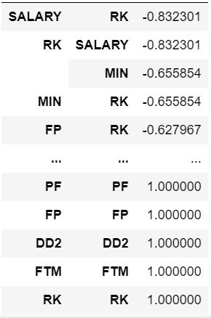
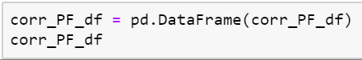
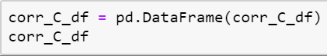
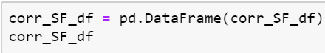
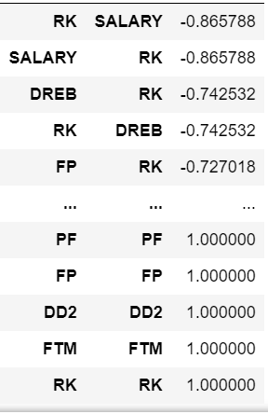
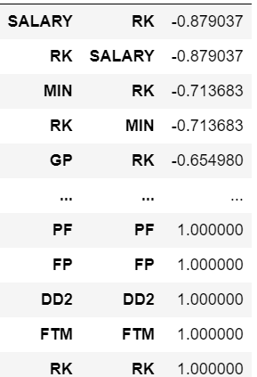
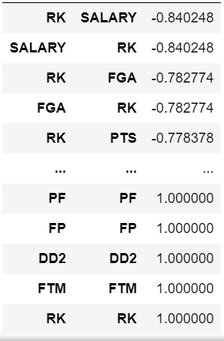
Correlation Results by Position

Slide 15
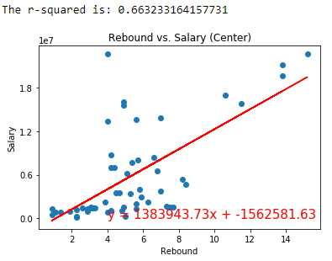
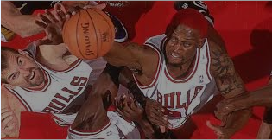
Center Position
Statistic awarded to a player who retrieves the ball after a missed field goal or free throw
Height is so important, most rebounds are made by centers

Slide 16
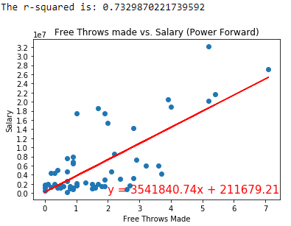
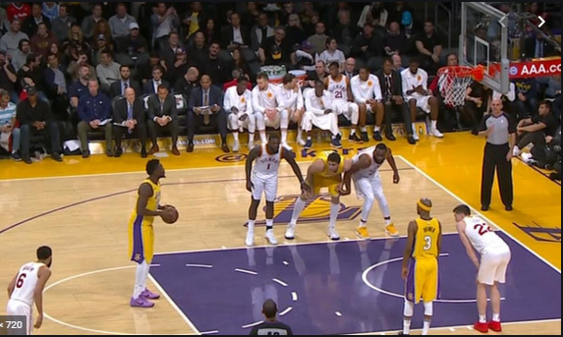
Power Forward
Free Throws are generally awarded after a foul on the shooter.
Most fouls happen inside the box.

Slide 17
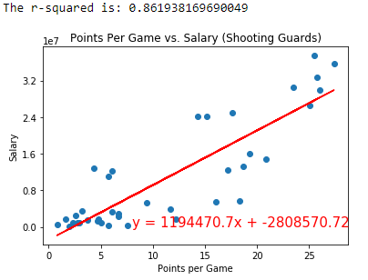

Shooting Guard
Ultimate objective of basketball is to score.
Shooting guards are known for their prolific scoring abilities.

Slide 18
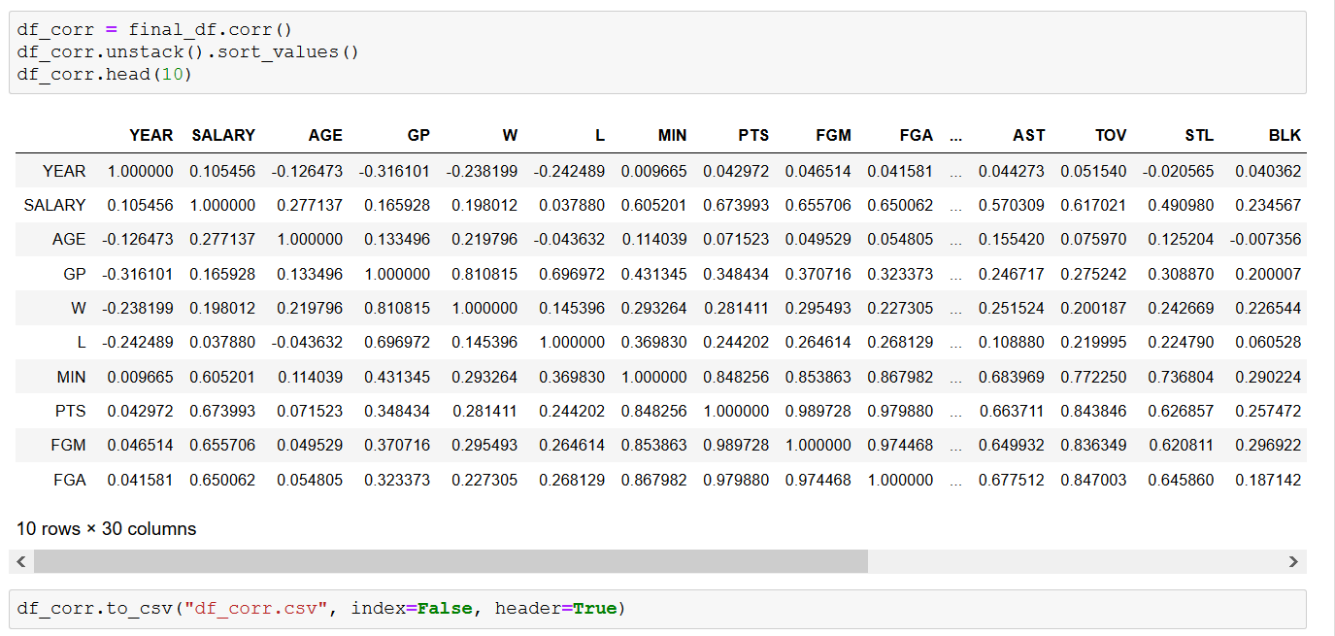
Analysis process
Finding correlation for all stats vs salary for all players in four teams:
We used the correlation function (df_corr.unstack().sort_values()) in Jupyter Notebook.
Display the Data Frame in Jupyter Notebook.
Export the Data Frame to CSV

Slide 19
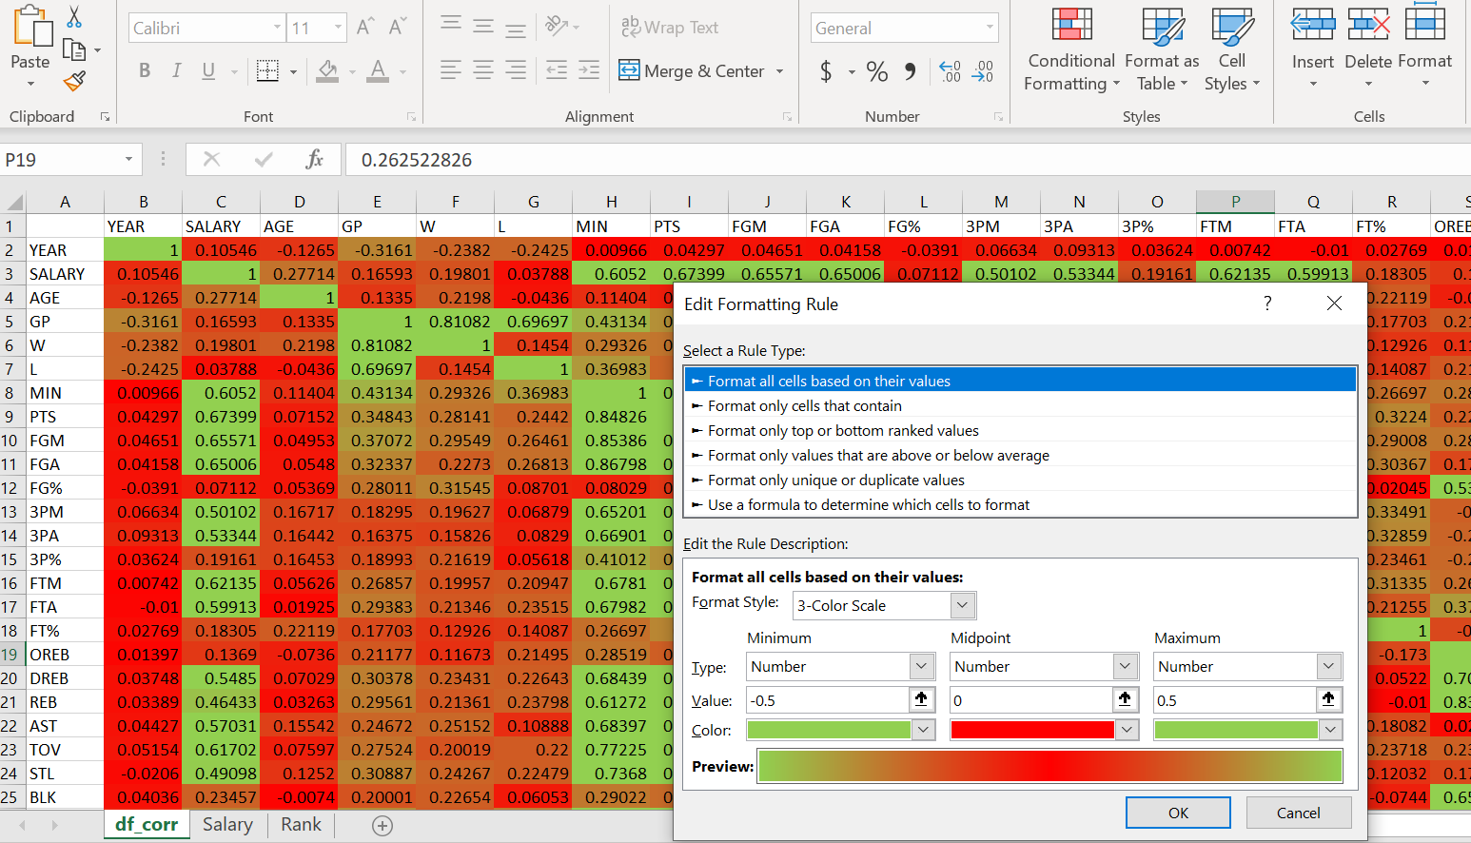
Correlation Analysis process
Finding correlation for all stats vs salary for all players in four teams:
Create conditional format rule in excel to visualize the correlation between salaries for all 324 players and each stats.
Visualize the details using excel chart
-0.3 < value < 0.3 - None or very weak correlation

Slide 20
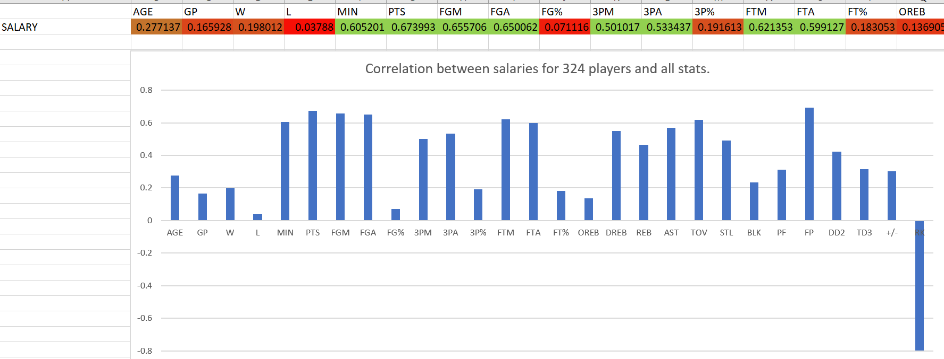
Correlation Analysis process
Finding correlation for all stats vs salary for all players in four teams:
Visualize the details using excel chart
-0.3 < value < 0.3 - None or very weak correlation

Slide 21
Top five stats affecting salary
Points vs Salary (r - value is 0.673993)
Field goals vs Salary (r - value is 0.655705)
Field goals attempted vs Salary (r - value is 0.650062)
Minutes Played vs Salary (r - value is 0.605200)
3 Point Field Goals Made vs Salary (r - value is 0.501017)

Slide 22
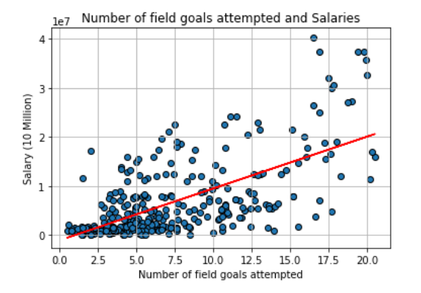
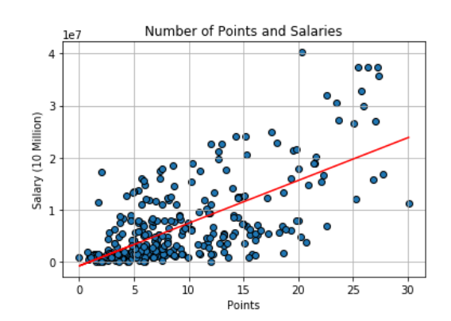
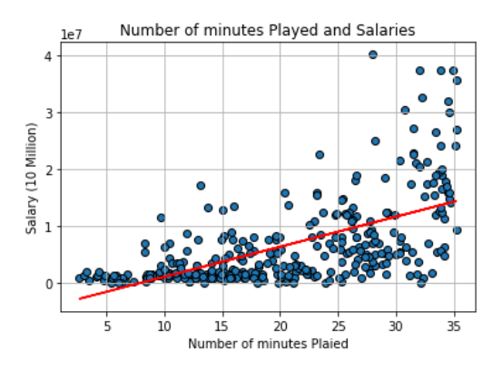
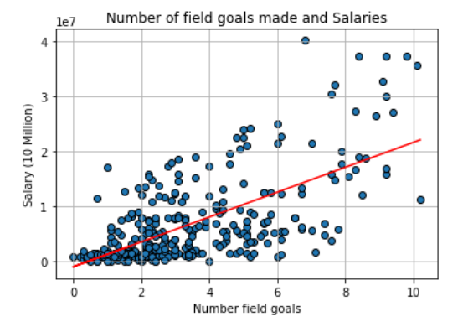
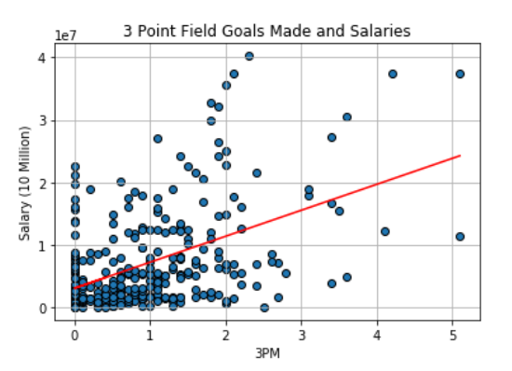
Top five stats affecting salary
Points vs Salary (r - value is 0.673993)
Field goals vs Salary (r - value is 0.655705)
Field goals attempted vs Salary (r - value is 0.650062)
Minutes Played vs Salary (r - value is 0.605200)
3 Point Field Goals Made vs Salary (r - value is 0.501017)

Slide 23
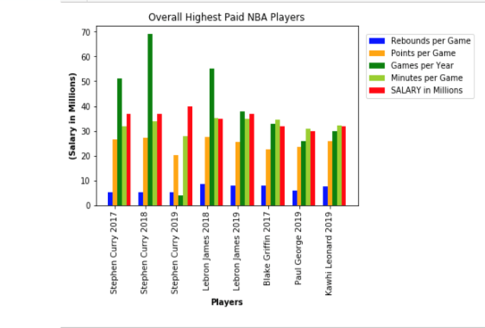
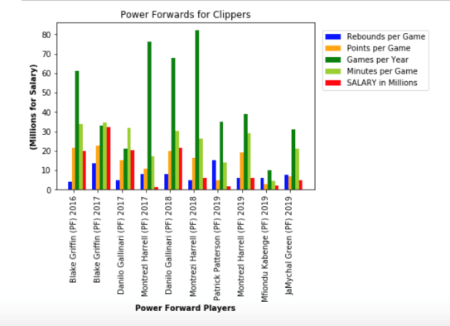
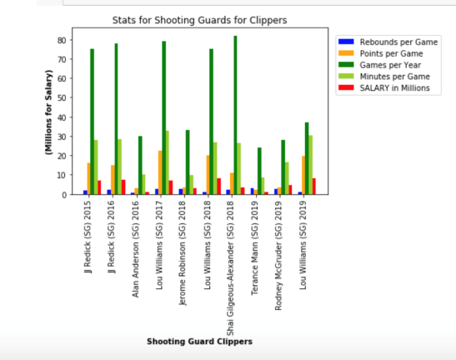
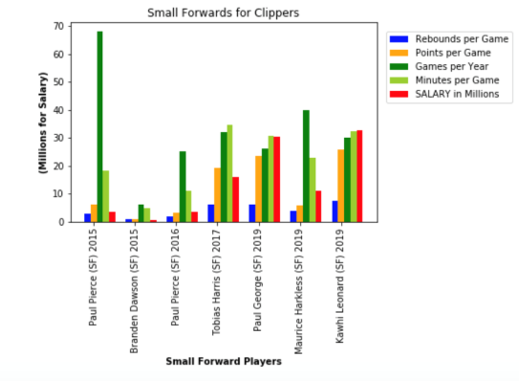
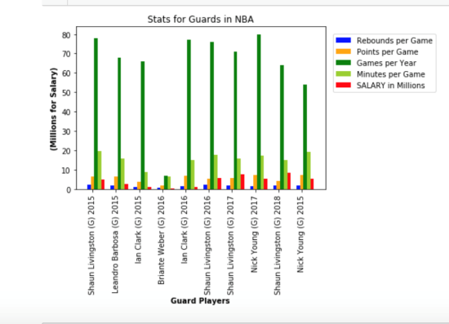
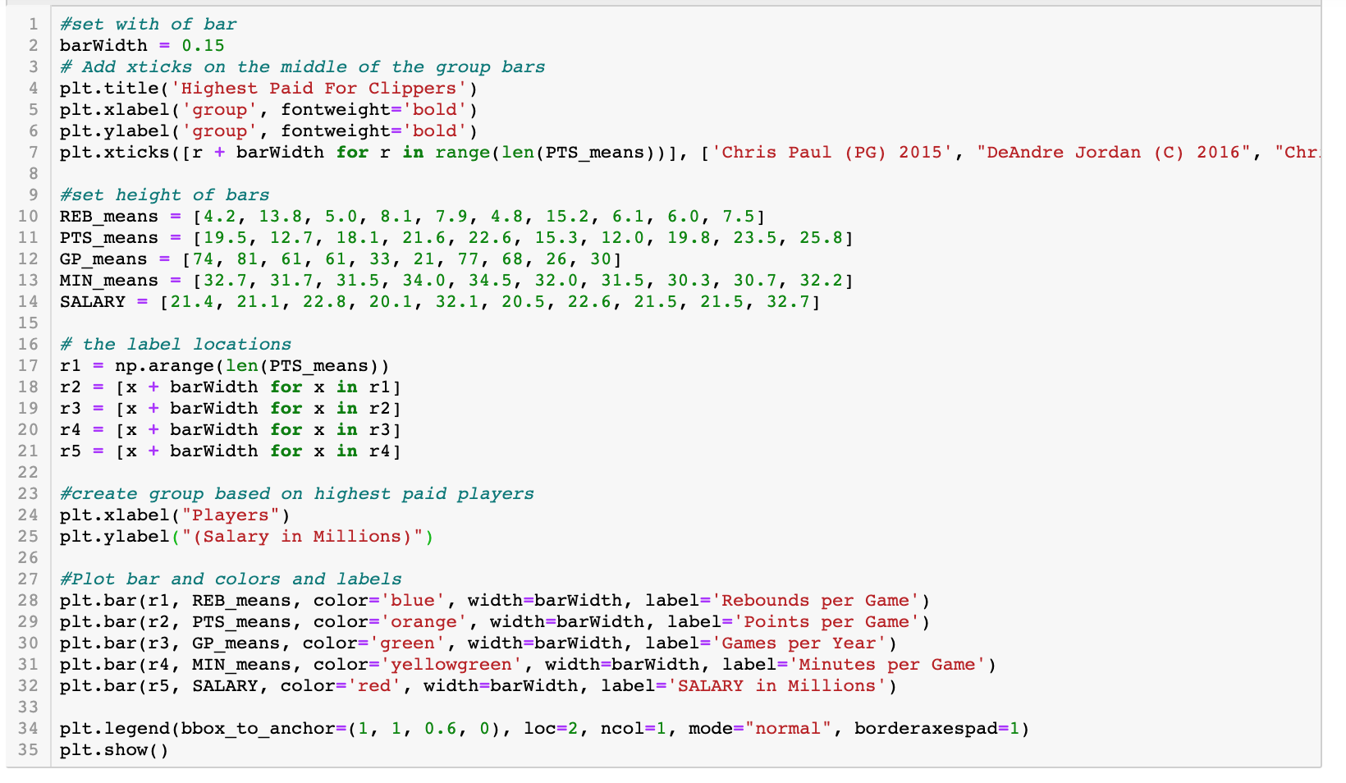
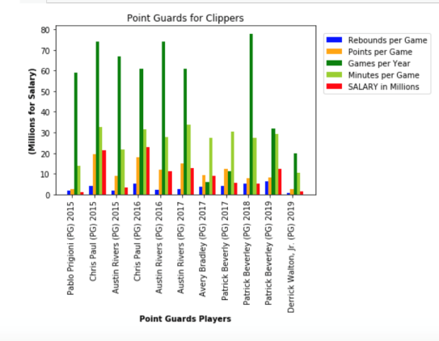
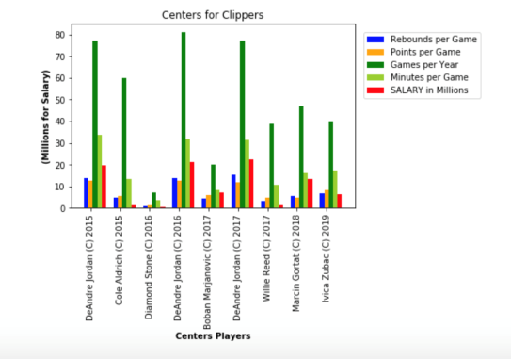
Analysis for Clippers
Matplotlib.pyplot allowed multiple bar graph displays
Small Forwards ranked with higher salaries in this comparison with players reaching close to $30 million salaries.

Slide 24
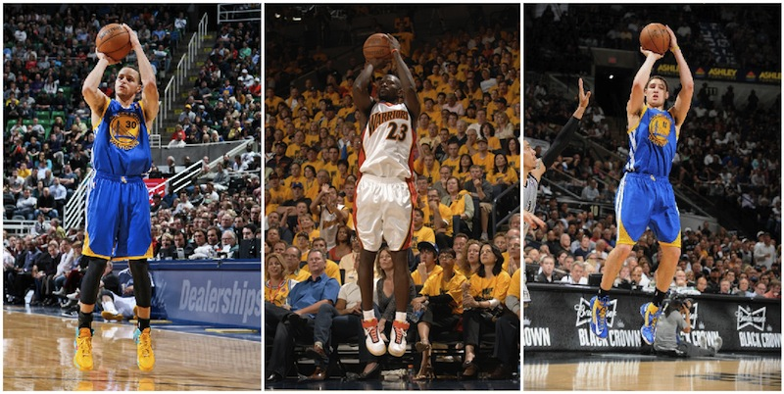
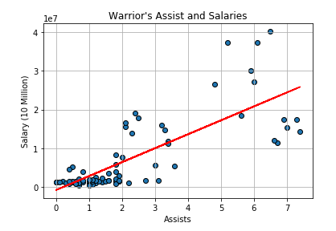
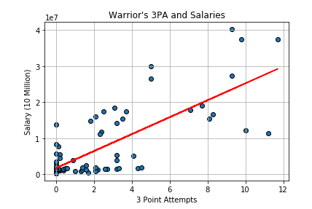

Valued Stats

Slide 25
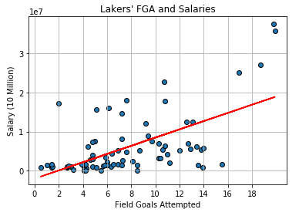

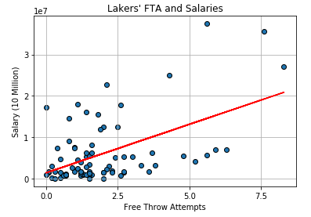
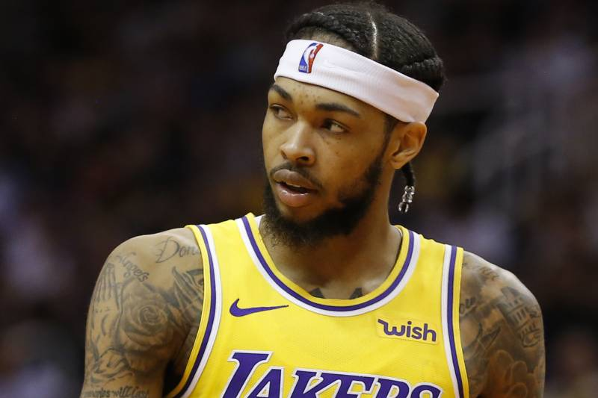


Valued Stats

Slide 26


Valued Stats
Clippers

Slide 27



Valued Stats

Slide 28
Conclusion and Finding
Based on our findings, the r-value has determined that ultimately, the main 5 factors affecting NBA salaries were:
Points
Field Goals Made
Field Goals Attempted
Minutes Played
3 Point Field Goals Made
And our recommendation for any player or any basketball players agent is to invest in developing these skills to be successful in basketball and get higher salary.

Slide 29


Bonus: Heatmap that shows which states spend the most on NBA player salaries by Year

Slide 30
Q & A

Slide 31
Thank you

